Slide 1
Knowing Me Knowing You
DIVERSITY WORKS

Slide 2
Mary Montague
21/01/2018

Slide 3
SESSION AIMS
To reflect on our identity and attitudes.
To reflect on our values
To reflect on our triggers
To hear how Restorative Practice helps us in our work

Slide 4
What is your present context ?
What are the positives elements of your work today?
What are the challenges for the you children?
What are the challenges for the parents / guardians / families
What are the challenges for you in your role?

Slide 5
Values
When you began looking for a career what values did you hold that helped you choose your profession?

Slide 6
Values in Family Care
Compassion Resilience Patience
Tolerance Adaptability Flexibility
Passion Respect Team Player
Compassion Kindness Reliability
Professionalism Empathy Self Motivated
Willingness to Learn Independent Worker

Slide 7
Values
In your role today what are the values that underpin your practice

Slide 8
Competition | Mastery
Creativity | Meaningful Work
Excitement/risk | Personal Development
Fame | Play
Family happiness | Pleasure
Financial security | Power
Humour | Recognition
Accountability | Responsibility
Knowledge | Stability
Leadership | Status & Reputation
Learning | Sensibility
Loyalty | Success
Making a Difference | Wealth

Slide 9
Diversity is the name of the game! First Thoughts is how we play it

Slide 10
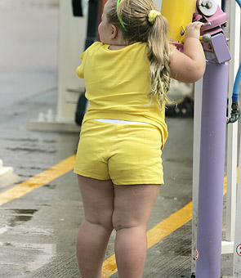
Picture 1

Slide 11
Picture 2

Slide 12
Picture 3

Slide 13
Picture 4

Slide 14
Picture 5

Slide 15
Picture 6

Slide 16
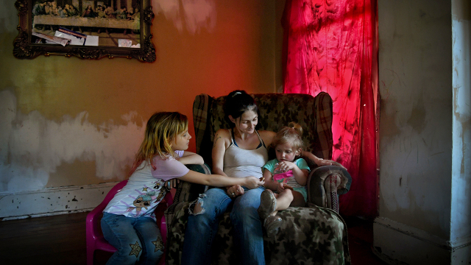
Picture 9

Slide 17
Picture 7

Slide 18
Picture 8

Slide 19
Picture 9

Slide 20
Picture 10

Slide 21
Reactions
What surprised you about your reactions to some of the images?

Slide 22
Processes:
Trigger
Reaction
Consequence
Trigger (Values)
Consider (Balcony)
Respond
What did you want?
What did you get?

Slide 23
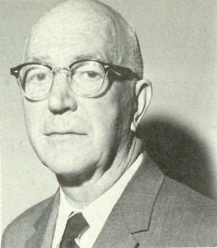
Gordon Allport
The Scale of Prejudice
References:
The Nature of Prejudice, Addison-Wesley; 1954.
23

Slide 24
Scale 1 Antilocution
(hate speech) means a majority group freely make jokes about a minority group. Speech is in terms of negative stereotypes and negative images. This is also called verbal rejection. It is commonly seen as harmless by the majority.
Antilocution itself may not be harmful, but it sets the stage for more severe outlets for prejudice. Examples are jokes about the Irish, French, blacks, gays etc.

Slide 25
Scale 2 Avoidance
(actively avoiding)People in a minority group are actively avoided by members of the majority group.
No direct harm may be intended, but harm is done through isolation

Slide 26
Scale 3 Discrimination
Minority group is discriminated against by denying them opportunities and services and so putting prejudice into action.
Behaviours have the specific goal of harming the minority group by preventing them from achieving goals, getting education or jobs, etc.
The majority group is actively trying to harm the minority.

Slide 27
Scale 4 Physical Attack
The majority group, acts of vandalism directed at minority group things, they burn property and carry out violent attacks on individuals or groups. Physical harm is done to members of the minority group
Examples are lynching of blacks, pogroms against Jews in Europe, tarring and feathering Mormons in 1800s

Slide 28
Scale 5 Extermination
The majority group seeks extermination of the minority group. They attempt to liquidate the entire group of people
e.g., Indian Wars to remove Native Americans,
Final Solution of Jewish Problem, or The Roma People, Ethnic Cleansing in Bosnia or Sudan etc.).

Slide 29
Allport Today
Is there any special relevance to you and your role?
Do we see a relevance in this scale of prejudice today?

Slide 30
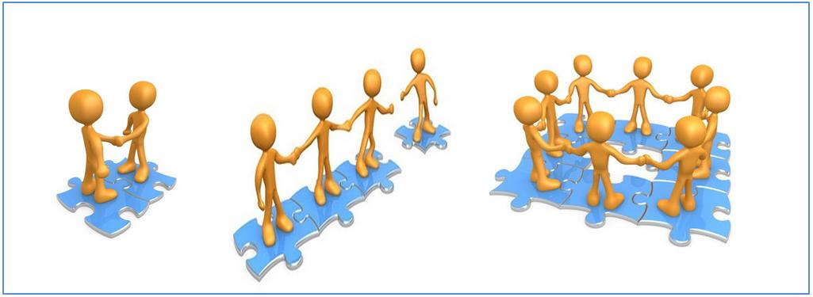
What is Restorative Practice?
A way of being that enables people to restore and rebuild relationships after conflict, disagreement and harm.
People in authority do things with children/youth/adults rather than for or to them
Restorative Practice allows children/youth /adults to participate fully in decision –making processes that effect them.
Its enables and empowers all those involved in the processes.

Slide 31
Control
TO Authoritarian (I win/you lose) Because I Say so Low nurture Low Communication High expectations High Control | WITH Authoritative (I win/you win) Let’s figure it out together High nurturing High communication High Expectations Moderate control
NOTHING Neglectful/Avoid (I lose you lose) Whatever I don’t care. Low nurture Low Communication Low Expectations Low Control | FOR Permissive (I lose/you win) Whatever you say High Nurture Moderate Communication Low Expectations Low Control
High
C
O
N
T
R
O
L
/
S
T
R
U
C
T
U
R
E
LOW High
Nurturing (encouragement/support)

Slide 32
Restorative Circles
Used along the continuum
Topics can include anything thing from civic responsibility to likes and dislikes
Sharing
Solutions Based
Support
Debate
Conflict

Slide 33
Our Wee Ruth’s Story

