Slide 1
Finding Hope in Addiction & Recovery Through FGDM
Eliza White, MSW Program Development Specialist Felicia Matriccino, Parent Ambassador

Slide 2
Session Purpose
This workshop will focus on the importance of engaging families at each step of the way and the benefits of building a lifetime network of support. Additionally, while learning about the process, participants will also hear from a parent who participated in FGDM conferences and about her experiences at each of those steps. We will be exploring engagement strategies with special consideration and discussion regarding the work with parents who experience substance abuse issues which include the family dynamic and safety planning before during and after the conferences.

Slide 3
Overview of FGDM & Substance Use
FGDM and Substance Use in PA​
Substance use effects​
Resources for treatment​
Need to address mental health & medical needs​
Understanding dependency​
Both individuals & their families​

Slide 4
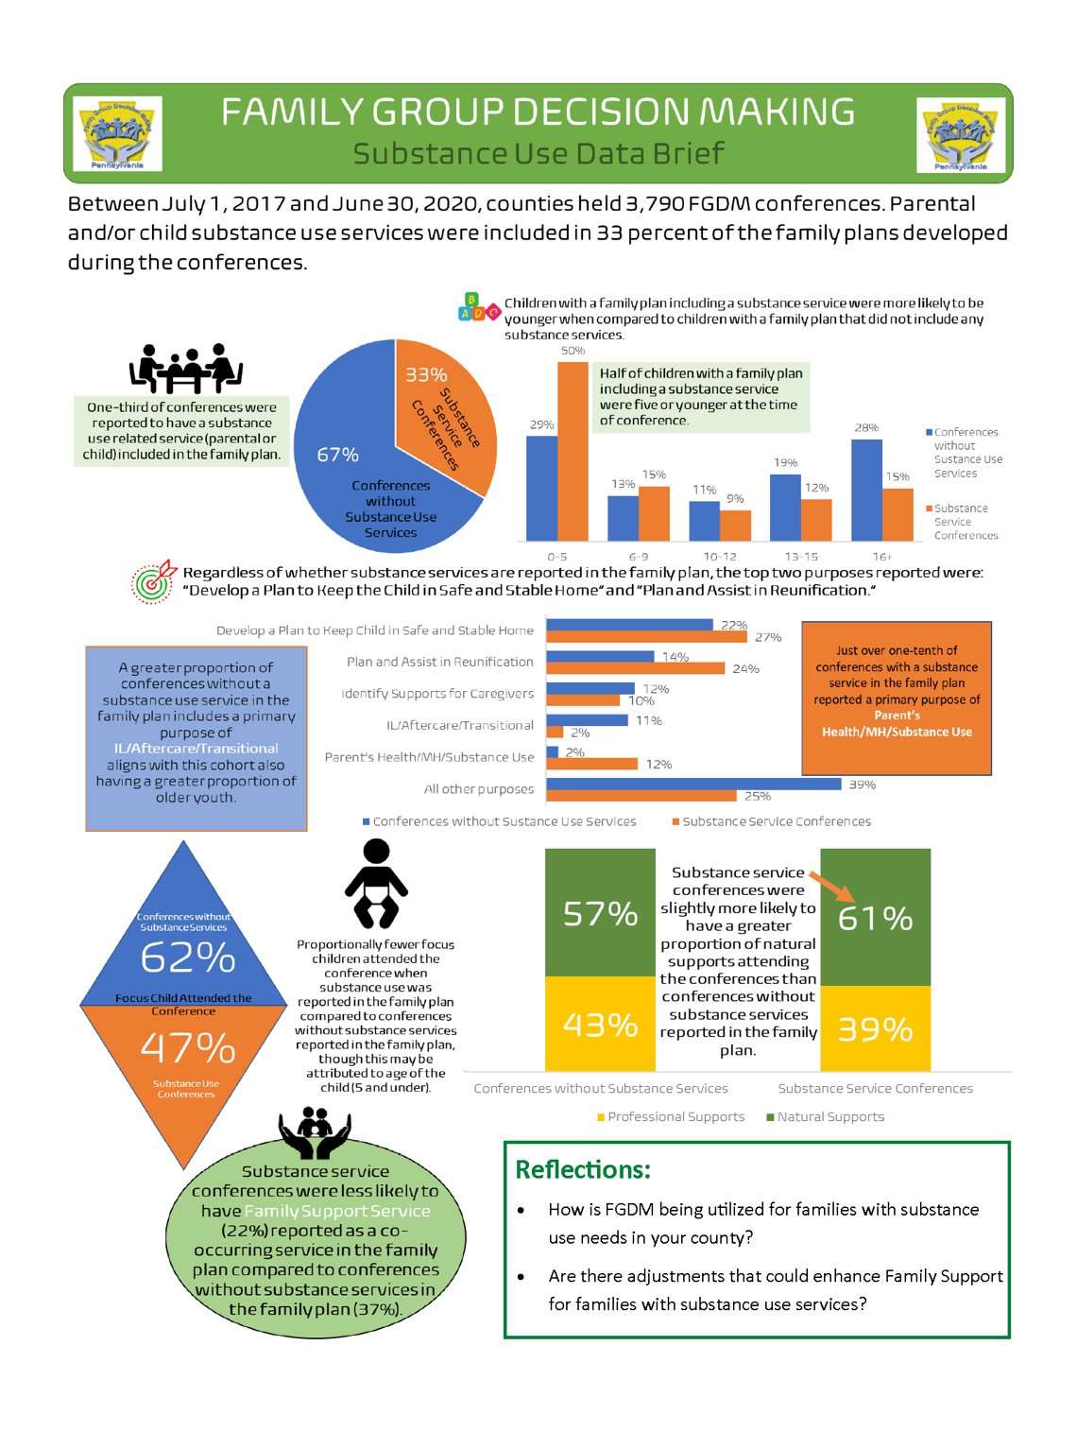

Slide 5
Points of Engagement and Teaming Through the FGDM Process
Before the meeting occurs (coordination)​
During the FGDM meeting (facilitation)​
After the meeting/Follow-up

Slide 6
Continuous
Understanding​
Relationships
Teaming
Transparency
Never Ending
Reunification
Inclusion
Connections
Preparation
Emotions
Conversations
Recovery
Family Time
Change
Food
Healing
Role/Voice
Professional Mindfulness
Accountability

Slide 7
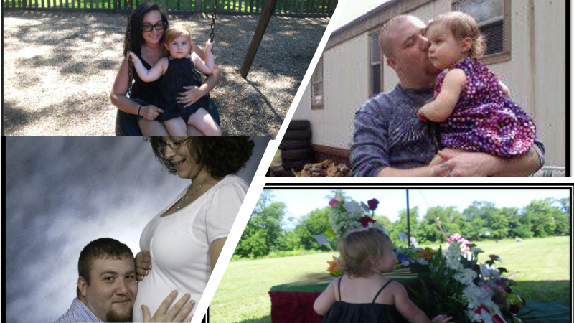

Slide 8
CONTINUOUS Points of Engagement
Before FGDM
Approached 3x about FGDM – Letters, Courts, Professional & Family Approach
Getting to a Place of UNDERSTANDING – No idea/understanding of process
No Trust (Family or Professionally)
During FGDM
Roles in family’s life
Bonds created
Hard conversations
After FGDM
Understood what the plan was, still needed to learn to walk through things as a family
Roles Changed
Never Ending

Slide 9
Before
Engaging One to One
Listening – Trust building
Explanation of process & expectations, focus points (Reunification)
Options available Who? Why/Not
Timeframes expected to reach
Best for child vs self
Family Dynamics Behind the Scene
Some conversations with them for the 1st time if in months
Reaching out to me acknowledging CYS contact
Desire to be there for both my daughter & me
Not sure what to expect but willing to participate
Unsure of exceptions on them

Slide 10
During
Understanding what CYS expectations ​
Our family members voicing what they wanted to see happen​
Agreement between CYS and my family on goals that needed to be reached before my daughter could return home​
Private family time allowed us to get real, hear each other & plan together ​
CYS accepted our plan as we wrote it and acknowledged what we accomplished together​
Breaking down the barriers in our family relationships and building trust among us

Slide 11
After
CYS followed up with us through phone calls, meetings and informal meetings before or after court hearings ​
My family dynamics changed but the plan remained the same​
Family accountability was about recovery and so much more ​
Lifetime connections with supports was my biggest takeaway from FGDM and our family's greatest accomplishment​
My recovery will never end, and my lifetime connections play an important role in my life ​

Slide 12
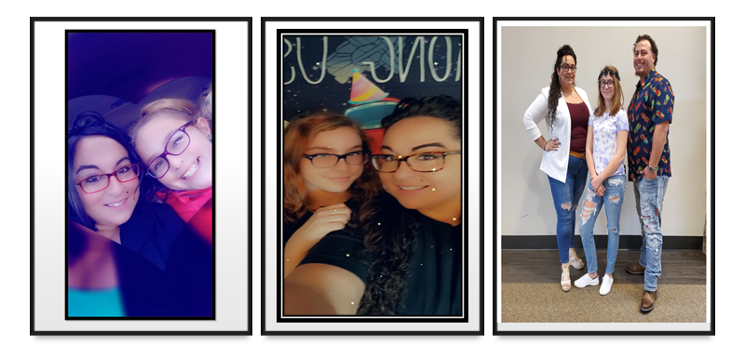

Slide 14
Summary and Key Points
Are there specific takeaways from this workshop that you will consider when engaging individuals suffering from addiction? ​
How will you use this information in the future? ​
What do you want to learn more about pertaining to engagement and teaming with individuals and families experiencing addiction? ​

Slide 15
Thank you for joining our session today!

Slide 16
Guiding Questions
Do you know someone that has an addiction?
How was addiction impacted their lives, as well as their families’ lives?
Do you believe that individuals with substance use intend to negatively impact the lives of those closest to them?
How can we support and engage those that are active in their addiction to seek treatment?
How can we support and engage those that are in recovery?
How can we show parents and family members that they are valued team members?
Are there extra considerations we should make when holding meetings with individuals experiencing substance use and/or are in recovery? Specific safety considerations?
What resources do you find most valuable for individuals and families experiencing addiction?

