Slide 1
THE NATURE OF ADDICTION & THE TREATMENT OF ADDICTION
Kimberly C. Kirby, Ph.D., BCBA-D
Senior Scientist
Director, Behavioral Treatments & Applications Research
Director, Parents’ Translational Research Center
Notes:
Thanks for the opportunity to speak with you today
I will begin with the discussion of the nature of addiction – considering when it starts and factors that contribute to its development, and why it is difficult for addicted people to stop, even though they may be facing horrible consequences.
Then I will briefly present some general information on the treatment of addiction, what the research shows us about treatment in general, and some of the challenges involved in getting research findings out into community treatment settings.
Next, MaryLou will be presenting findings and recommendations specific to the substance using parents. She’s the one who has direct experience working with addicted parents – my experience is focused more on working with non-addicted family members; the concerned parents and spouses of addicted individuals.

Slide 2
Addiction- A Disease of Adolescence
Notes:
Addiction is a developmental disease that usually begins in adolescence. For example, 67 percent of those who try marijuana for the first time are between the ages of 12 and 17. This slide illustrates the age at which drug dependence is first diagnosed, which for tobacco, alcohol and marijuana, is typically in adolescence or early adulthood.

Slide 3
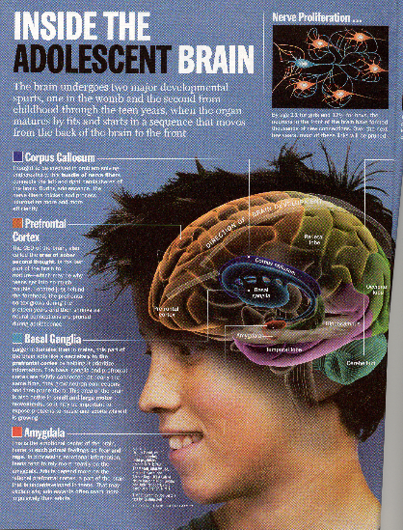
The Role of Brain Development
We thought brain development was complete by adolescence
We now know… maturation is not complete until about age 25!!!
Notes:
It turns out that the developing adolescent brain may predispose teens to become addicted.
Recent research has indicated that our brains are not fully developed until about the age of 25. Therefore the initial decision to start using and subsequent decisions to continue use sufficiently to develop an addiction, are all made by an immature brain that does not function in the same way as adult brains.

Slide 4
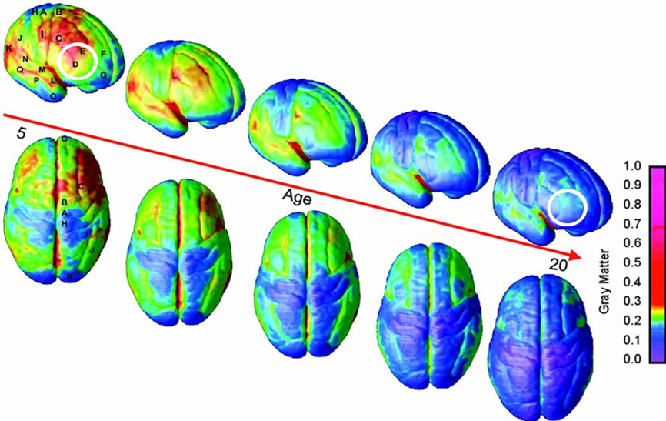
MRI Scans of Healthy Children and Adolescents
Copyright @2004 by the National Academy of Sciences
Gogtay , Giedd, et al., Proc. Natl. Acad. Sci., 2004
Notes:
Magnetic Resonance Imaging (MRI) Scans allow us to map the maturation of the brain. This slide illustrates brain development through early adulthood, with blue indicating the mature state. The prefrontal cortex (white circle), which governs judgment and decision-making functions, is the last part of the brain to develop. This may help explain why teens, who are more prone to participating in risk-taking behavior, are particularly vulnerable to drug abuse.

Slide 5
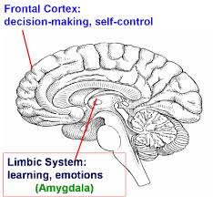
Limbic System Develops 1st Frontal Cortex Develops Later
Earlier: Limbic system
Processing emotions
Processing social info
Experience reward, punishment
Later: Prefrontal cortex
Deliberative thinking
Logical reasoning
Planning ahead
Weighing costs & benefits
Regulating impulses
Notes:
Previous slide showed that maturation begins at the back of the brain at gradually moves forward to the frontal cortex, which is involved in complex decision-making and self-control. This diagram also shows is the limbic system of the brain, which develops earlier. The limbic system processes emotions and experiences of reward and punishment.
It's important to note that his drug abuse begins developing, the majority of the immediate consequences that the user experiences are positive or rewarding. Decades of research have shown that drugs themselves can function to reward drug-taking, probably because of the subjective experiences of a high, a rush, or a numbing from pain.
The horrible negative consequences that can result from drug use often are quite delayed and uncertain relative to the positive effects that occur immediately after taking the drug. There is a wealth of research that shows that immediate consequences for behavior are much more powerful in driving that behavior than are delayed and uncertain consequences.

Slide 6
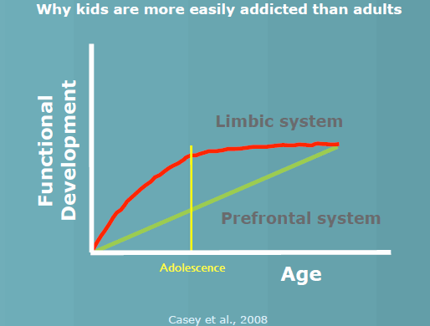
Imbalanced Neurodevelopment
Notes:
We often think of the limbic system as the "go system" of the brain. In contrast, the prefrontal system is the part of the brain that causes us to stop and think about longer term consequences and to weigh the costs and benefits of her behavior.
This graphical representation of a 2008 study shows that there is a period in adolescence when the brain’s drive for pleasure and new experiences is strong, but its “brakes” are not mature. This is why adolescents have more trouble than adults in controlling their impulses, and why adolescents may know what they should be doing but have trouble doing it. This graphic also explains why adolescents are more vulnerable to becoming addicted to substances.

Slide 7
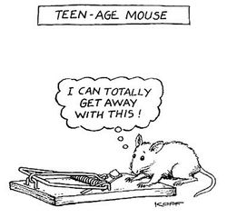
Implications of Brain Development for Adolescent Behavior
Notes:
So overall, these differences in brain development may lead adolescents to behave in ways that are "typically adolescent." That is to show a strong preference for very active, novel, exciting and rewarding activities; to have trouble controlling their emotions; or stopping to think about long-term consequences. It may also contribute to the observation that adolescents tend to be more influenced by their peers.

Slide 8
When Making Decisions Adolescents & Adults Use Different Parts of the Brain
NIDA
Deborah Yurgelon-Todd 2000
Notes:
A study published in the year 2000 demonstrated that adults use the frontal cortex to make decisions while teens rely more on the limbic system – the emotional areas – when making decisions. In this study, brain activity was measured via functional MRI, when an adult or adolescent was judging emotion represented on a face. It found that teenager’s amygdala (right) was activated, likely reflecting more of a gut reaction than a reasoned one. In contrast, the prefrontal cortex, involved in reasoning and reflection was activated in the adult brain (shown on the left).

Slide 9
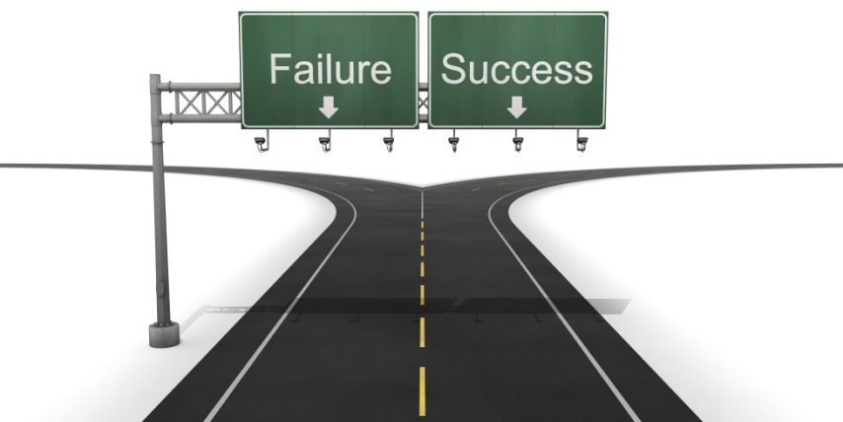
WHY DO SOME ADOLESCENTS BECOME ADDICTED WHILE OTHERS DON’T?
Addiction
Drug-Free
Notes:
It is true that many teens experiment with drugs and alcohol, but a minority of them become addicted. Overall, about one in 10 people who tried marijuana become addicted to it. However, adolescents who try marijuana are over nine times more likely to develop dependence than adults who try marijuana (Chen et al., 2009).

Slide 10
Notes:
So, the developing brain probably plays a role in the development of drug dependence, but research has also taught us that addiction is a complex disease, influenced by a multitude of highly entangled factors. No single factor determines whether someone will or will not become addicted to drugs. It is combination of biology, genetics, and environment, and these variables interacting very complicated ways.
Let’s start with genetics and biology.

Slide 11
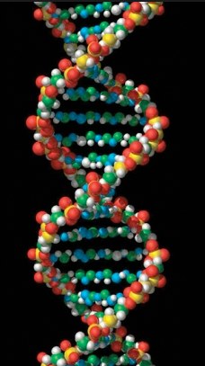
Genetic Contribution Large & Complex
Notes:
Studies have shown that 40-60 percent of the predisposition to addiction can be attributed to genetics. Of course, having genes that predispose you to addiction does not mean that you will necessarily become addicted. The expression of the genes to produce addiction occur only with the added impact of the environment. Taking drugs is, of course, a necessary environmental risk factor for addiction, but so are exposures to other environmental factors. Growing knowledge about the dynamic interactions of genes with the environment and developmental stage confirms addiction as a complex and disease of the brain with many contributors to its expression in individuals.
Genome wide analyses are being used to identify novel candidate genes that increase the risk for addiction. Scientists have identified a cluster of three nicotinic receptor subunit genes linked to smoking quantity, nicotine dependence, and the risk of two smoking-related diseases––lung cancer and peripheral arterial disease. This new information on genetic vulnerability also suggests novel targets for the development of medications to treat tobacco addiction and related diseases.

Slide 12
Notes:
Individual physiological differences can also contribute to a person’s susceptibility to addiction. For example, the level of dopamine receptors in a person’s brain can influence whether they “like or dislike” the effects of a particular drug.
Dopamine is a brain chemical involved in many different functions including movement, motivation, reward — and addiction. Nearly all drugs of abuse directly or indirectly increase dopamine in the pleasure and motivation pathways and in so doing, alter the normal communication between neurons.
Because dopamine is involved in the rewarding effects of drugs of abuse, it was hypothesized in this study that normal variation in the of number of dopamine receptors in a person’s brain could influence their response to drug exposure. To test this, human subjects were given the stimulant methylphenidate (Ritalin), their brains’ were imaged using PET, and they were asked whether they liked or disliked the drug’s effects. Those subjects who had high levels of dopamine receptors found the experience unpleasant, while those with lower levels of dopamine found it more pleasurable. This suggests that individual differences in a marker of dopamine function can influence an person’s susceptibility to continued drug abuse.

Slide 13
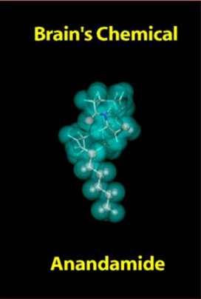
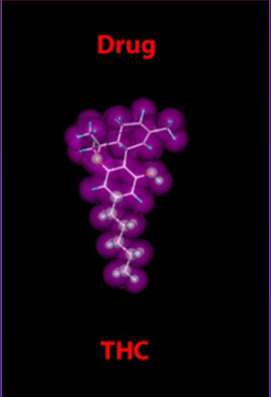
How Do Drugs Affect the Brain?
Drugs can Imitate Neurotransmitters
Notes:
How is it that drugs can affect the brain? Often, the chemical structure of drugs is similar to brain chemicals or neurotransmitters. Similarity in structure allows them to be recognized by neurons and to alter normal brain messages. Illustrated in this slide is THC, the active ingredient found in marijuana. It’s chemical structure is highly similar to anandamide, which is involved in a variety of functions including regulation of pain, appetite, memory, and mood.

Slide 14
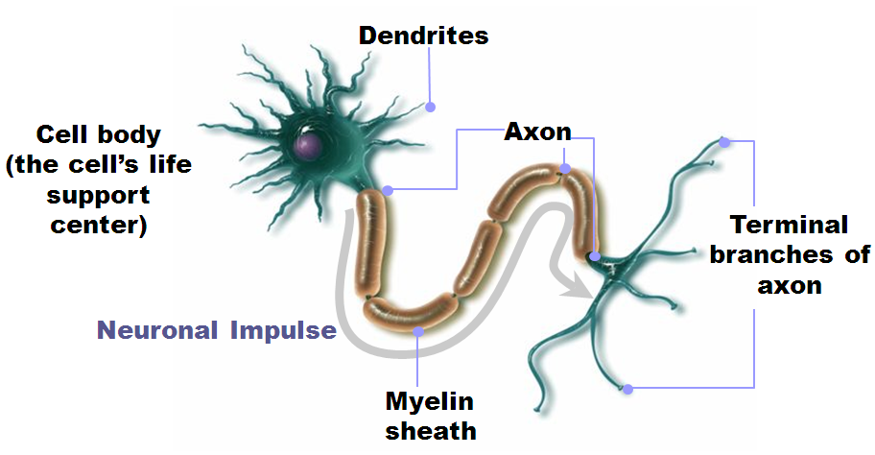
Neurons Communicate with Each Other via Neurotransmitters
Donald Bliss, MAPD, Medical Illustration
Notes:
Neurons are the brain’s messaging system. The brain consists of billions of neurons, or nerve cells, that communicate via chemical messages. How do they communicate with each other? This is a schematic drawing of a neuron. Towards the left of the diagram is the cell body, where neurotransmitters are made. Extending outward from the cell body are dendrites, which receive information from other neurons. When the cell body is sufficiently stimulated, an electric pulse is generated and subsequently travels down the axon to the terminal region of the cell. Once the impulse reaches the nerve terminal, neurotransmitters, such as dopamine are released into the gap between neurons. These chemicals can then attach to receptors located on the dendrites of neighboring neurons, thus transmitting information from one cell to the next within the brain and other parts of the body.

Slide 15
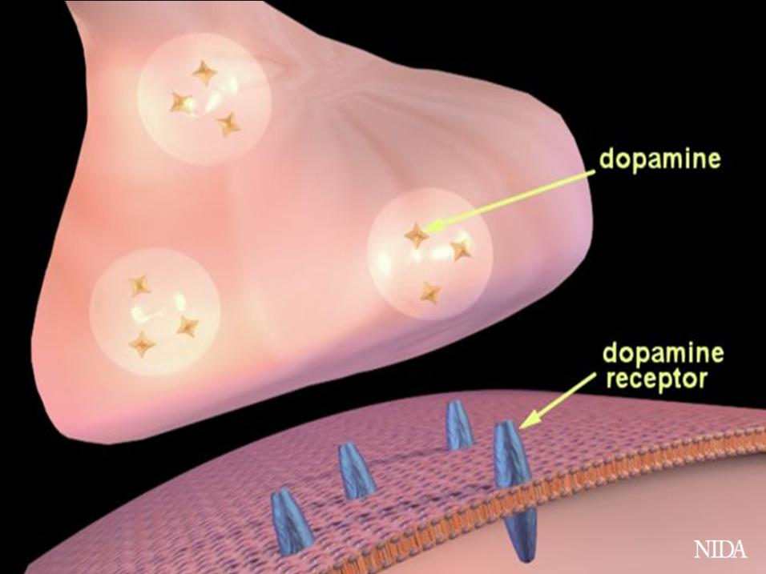
Notes:
This slide and the one that follows show how neurotransmission works specifically for dopamine. What is schematically illustrated in this slide is a nerve terminal (top), the synaptic cleft or space between the neurons, and the post-synaptic or receiving portion of a dendrite on a neighboring neuron. Dopamine is contained in vesicles (round storage sites) in the nerve terminal; dopamine receptors are present on the receiving (bottom) neuron.

Slide 16
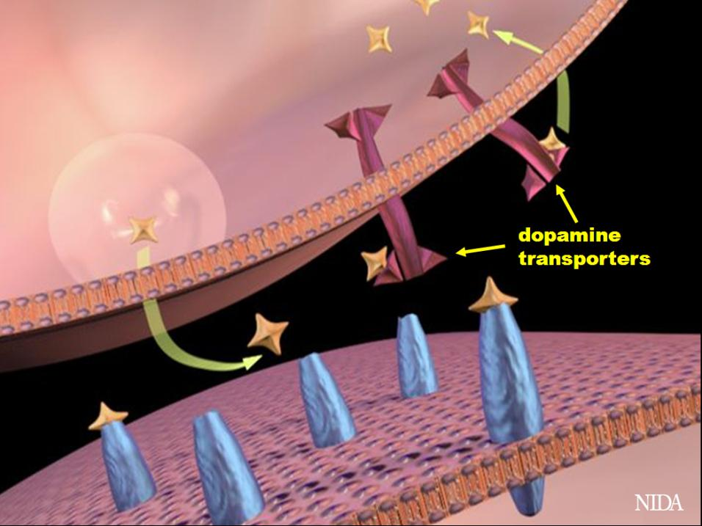
Notes:
When a signal comes down the axon, dopamine (shown in orange) is released into the synapse. It then crosses the synaptic cleft to the second neuron, where it binds to and stimulates dopamine receptors (shown in blue), generating a signal in the second neuron. The dopamine is then released from the receptor and crosses back to the first neuron where it is picked up by dopamine transporters (reuptake molecules; shown in purple) for re-use.

Slide 17
Notes:
Natural rewards stimulate dopamine neurotransmission. Eating something that you enjoy or being stimulated sexually can cause dopamine levels to increase. In these graphs, dopamine is being measured inside the brains of animals. Its increase is shown in response to food or sex cues. This basic mechanism of controlled dopamine release and reuptake has been carefully shaped and calibrated by evolution to reward normal activities critical for our survival.

Slide 18
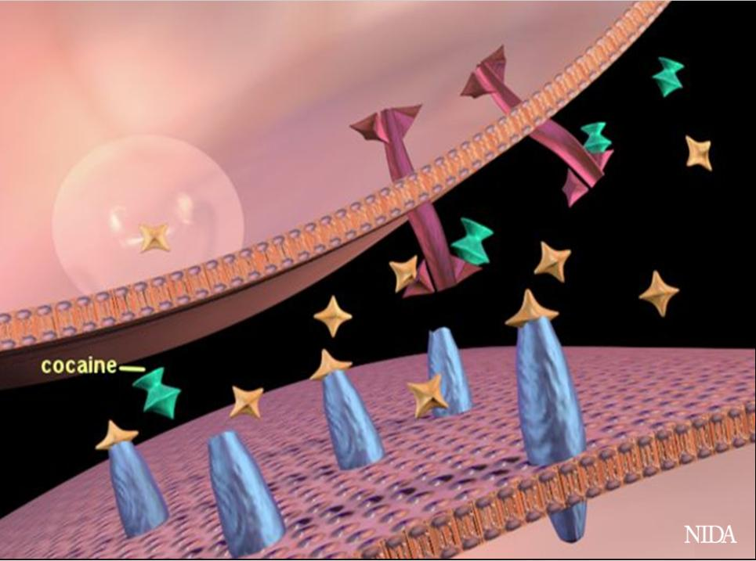
Notes:
But what happens when a person takes a drug? This slide shows how cocaine is able to alter activity in the synapse. Cocaine (shown in green), attaches to dopamine transporters (shown in purple), thereby blocking dopamine from being taken back up by the first neuron. Thus dopamine can continue to stimulate (maybe over-stimulate) the receptors of the second neuron because it remains in the synapse for a longer period of time. This duration of stimulation and amount of dopamine in the synapse is far greater than what normally occurs when a person engages in an enjoyable activity (e.g., eating, sex, etc), and is what produces cocaine’s intense euphoria and potential for abuse.

Slide 19
Notes:
Nearly all drugs of abuse increase dopamine neurotransmission. This slide shows the increase in brain dopamine (DA) levels (measured in animals) following exposure to various drugs of abuse. All of the drugs depicted in this slide have different mechanisms of action, however they all increase activity in the brain reward pathway by increasing dopamine neurotransmission. It is because drugs activate these brain regions⎯usually more effectively and for longer periods of time than natural rewards⎯that they have an inherent risk of being abused.

Slide 20
Dopamine
- Movement, motivation, reward
Notes:
Dopamine is an important brain chemical in drug abuse and addiction, but other brain systems and brain chemicals are also involved. Serotonin and glutamate neurotransmitter systems, for example, are among those affected. These neurotransmitters are important regulators of mood, sleep, learning and memory, and more.
Prolonged drug abuse changes the brain in fundamental ways that reinforce drug taking and lead to addiction. These changes are difficult to un-do and may last a long time.

Slide 21
Notes:
Drug abuse changes both the structure of the brain and its functioning
Exposure to some drugs of abuse can change the structure of neurons in the brain. In this case, the dendrites of dopamine neurons in the - part of the reward pathway—have more dendritic spines or connections in an amphetamine exposed animal compared to one treated only with saline.

Slide 22
Notes:
Repeated drug exposure also changes brain function. Positron emission tomography (PET) images show similar changes in brain dopamine receptors resulting from addiction to different substances. The brain images on the left are those of controls, while those on the right are from individuals addicted to cocaine, methamphetamine, alcohol, or heroin. Part of the brain (the striatum,which contains the reward and motor circuitry) shows up as bright red and yellow in the controls (in the left column), indicating numerous D2 receptors. Conversely, the brains of addicted individuals (in the right column) show a less intense signal, indicating lower levels of D2 receptors. This reduction likely stems from repeated over-stimulation of the dopamine receptors. Brain adaptations such as this contribute to the compulsion to abuse drugs.

Slide 23
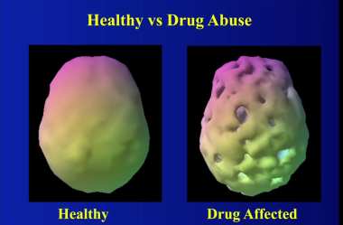
Structure and Function
MRI: Methamphetamine reduces gray matter
SPECT: Marijuana and other drugs changes brain function.
Notes:
Additional evidence regarding changes in the structure of the brain can be seen through magnetic resonance imaging (MRI), which is shown in the pictures at the top.
The yellow and red area in the central brain view indicates reduced gray matter density in the right middle frontal cortex (Kim et al., 2005). The same deficit is shown from other perspectives in the flanking views.
An analysis of MRI images disclosed that a group of chronic methamphetamine abusers had severe gray matter deficits in several areas of the brain. They also had smaller hippocampi than nonabusers of drugs. The hippocampus is a key site for memory storage, and the volume decrements correlated with poorer performance on a word recall test (Thompson et al., 2004).
Single photon emission computed tomography (SPECT) was used to take the pictures at the bottom. The high level of sensitivity of this brain imaging technique allows researchers to study drugs’ effects on key components of cell-to-cell communication, including cell receptors, transporters, and enzymes involved in the synthesis or metabolism of neurotransmitters (Volkow, Fowler, and Wang, 2003a). Although the picture looks as if there are structural changes leading to holes in the brain, it actually depicts changes in function.

Slide 24
Circuits Involved in Drug Abuse and Addiction: Long-Term Brain Changes
Notes:
So What are the areas of the brain that undergo long-term changes and what does that mean?
The areas depicted contain the circuits that underlie feelings of reward, learning and memory, motivation and drive, and inhibitory control.
Addiction changes brain circuitry, making it hard to “apply the brakes” to detrimental behaviors. In the non-addicted brain, control mechanisms are developed and inhibitory control can be applied as needed. In the addicted brain, this control circuit becomes impaired because of drug use and loses much of its inhibitory power over the circuits that drive responses.
So once a person is addicted, they are not able to respond is a way that is logical and makes sense to those of use who have mature brains that have developed normally.
ADDICTION REALLY IS A BRAIN DISEASE.
Key:
PFC – prefrontal cortex; ACG – anterior cingulate gyrus; OFC – orbitofrontal cortex; SCC – subcallosal cortex; NAc – nucleus accumbens; VP – ventral pallidum; Hipp – hippocampus; Amyg – amygdala

Slide 25
Notes:
Now let’s switch to the environment side of the equation

Slide 26
Environmental Factors
Experimentally Verified
Drug availability
Alternate rewards
Social context
Stress
Correlative
Early physical/sexual abuse
Witnessing violence
Parents/friends who use
Perceived Risk
Notes:
Many environmental factors contribute to a person’s propensity to take drugs of abuse. These include drug availability, access to alternate rewards, exposure to stress or a history of physical or sexual abuse, witnessing violence, and so forth.

Slide 27
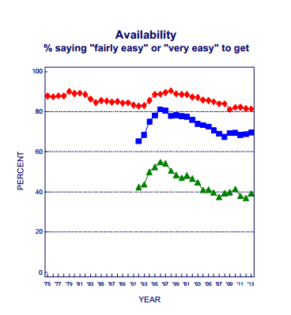
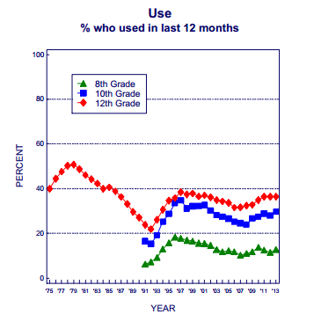
Drug Availability - Marijuana
Notes:
These data are from a nation-wide study that interviews 8th, 10th, and 12th grade students regarding their drug use. The slide on the left shows the percent of students saying that it's fairly easy very easy to get marijuana while the slide on the right shows the percent of students report using marijuana in the past 12 months. You can see that the data curves are similar in both graphs, steep increases in the perceived availability of marijuana from 1991-1997 and corresponding increases in the proportion of students using marijuana during the same years.

Slide 28
Alternate Rewards
Higgins et al. (1994) AM, J . DRUG ALCOHOL ABUSE, 20(1), pp. 47-56
Notes:
There are some really good laboratory studies showing this has an effect, but this is as close as I could get to a clinical study supporting the laboratory results.
This shows the results of a treatment where patients were asked to bring a significant person in their life (parent, spouse) into treatment with them. The treatment program shared the patient’s urine results with the SO, letting them know when the person provided a clean urine. The SO was supposed to reward the person by showing their appreciation and maybe doing something nice with them. Some patients brought a person in and other didn’t. Those who had an SO supporting them did significantly better than those who did not.

Slide 29
Social Context
Notes:
More people drink coffee (a stimulant) in the morning, before or during work, than late at night before they go to bed.

Slide 30
Notes:
How can the environment shape the response to drugs? This study in non-human primates shows how social factors can influence the level of dopamine receptors and the propensity to self administer drugs. Illustrated above are PET images of the brains of monkeys that were initially individually housed (left) and then group housed (right). Those emerging at the top of their social rank – experiencing less stress and more access to natural rewards – expressed more dopamine receptors (bright yellow) and took less cocaine than did submissive monkeys (green symbols on graph).

Slide 31
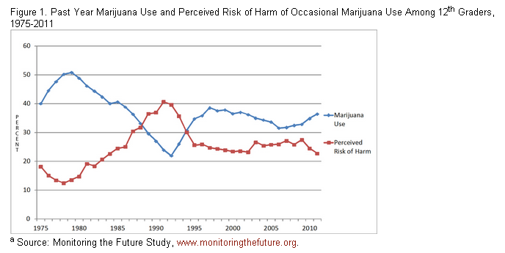
Social Norms (Perceived Risk)
Marijuana Use and Perceived Risk of Harm of Use Among 12th Graders
PERCENT
Monitoring the Future, www.monitoringthefuture.org
Notes:
Past Year Use

Slide 32
Addiction a Chronic Illness Similar to Other Chronic Illnesses
Biological & behavioral components - both must be addressed during treatment
Recovery often a long-term process requiring repeated episodes of treatment
Relapses can occur and signal a need for treatment adjustment or reinstatement

Slide 33
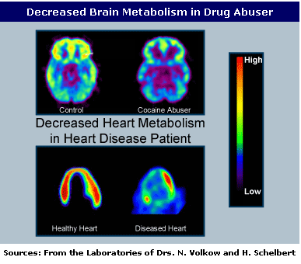
Similar Metabolic Changes
Notes:
Imaging studies have shown evidence of tissue malfunction in the brains of those with addiction, and in the hearts of people with heart disease.
With all these structural and functional changes, can treatment help?

Slide 34
Addiction Recovery: Similar to Other Chronic Diseases
Drug Abuse
Cardiovascular Disease
Stay active in healthy activities: sports, arts, education
Know your family history
Reduce stress and develop positive coping strategies
Get treatment when needed and adhere to the regimen
Engage in healthy eating and exercise
Know your family history
Reduce stress and develop positive coping strategies
Monitor your cholesterol, blood pressure
Get treatment when needed and adhere to the regimen
Notes:
This slide shows that there are similarities in the recovery process for addiction and heart disease. But wait, we all know that addicted folks are much worse at following their treatment plan and more likely to relapse, RIGHT?

Slide 35
Relapse Rates of Chronic Diseases
McLellan et al., JAMA, 2000
Notes:
Drug abuse is a chronic illness with relapse rates similar to other chronic illnesses

Slide 36
Notes:
Treatment Can Work! More than 30 years of research have shown this to be true. Behavioral therapies can engage people in treatment, modify their attitudes and behaviors related to drug abuse, and increase their life skills. Medications are now available to treat opioid, alcohol, and tobacco addiction, while others are on the horizon. Behavioral therapies can enhance the effectiveness of these medications and can help people stay in treatment longer.

Slide 37
Notes:
Addiction requires treatment that addresses its complexity. Substance abuse treatment should address the whole person and can include medications, behavioral therapies, and ancillary support services that help to connect people to needed social, medical, and employment services, to get their lives back on track.

Slide 38
Notes:
Extended abstinence is predictive of sustained recovery. The odds of remaining abstinent rise if patients have been abstinent for 1 to 3 years. After 3 years, the recovery odds remain high and stable. Therefore, as with other chronic diseases, addiction requires an ongoing and active disease management strategy.

Slide 39
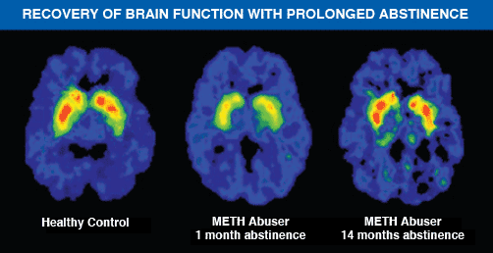
The Brain Can Recover
Notes:
It takes time, but the brain can recover. This slide shows images of dopamine transporter (DAT) binding in three brains: (1) a healthy control (top); (2) a methamphetamine abuser one month after discontinuing drug abuse (middle); and (3) a methamphetamine abuser after 14 months of abstinence (bottom). The control brain shows a robust concentration of dopamine transporters in the striatum (red and yellow), while the methamphetamine abuser has a dramatic drop in DAT binding, even a month after drug abuse has stopped. Sustained abstinence, however, allows a near-full return of DAT binding to normal levels. Still, some of the behavioral effects of methamphetamine do not completely return to normal (not shown). This means that it can take a long time to recover from methamphetamine abuse, but recovery is possible.

Slide 40
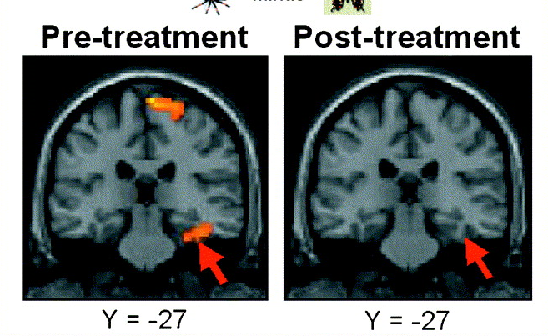
Behavior Therapy Changes the Brain
Paquette et al. (2003). Neuroimage, 18:401—409
Notes:
Brain scan of a person with spider phobia exposed to a spider before and after CBT.
fMRI was used in subjects suffering from spider phobia to measure, before and after effective CBT, regional brain activity while viewing film of spiders. Results showed that fear triggered during the viewing of the spiders, was correlated with significant activation in the brain. After successful completion of CBT, no significant activation was found in those brain areas.

Slide 41
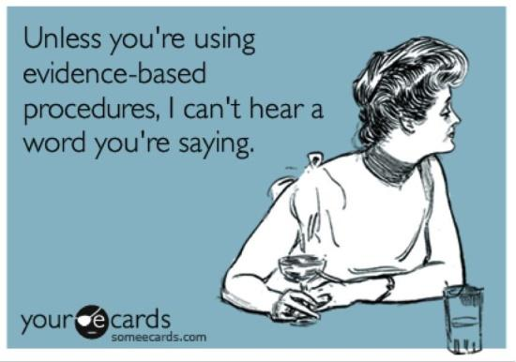
What Kinds of Therapy for Addiction?

Slide 42
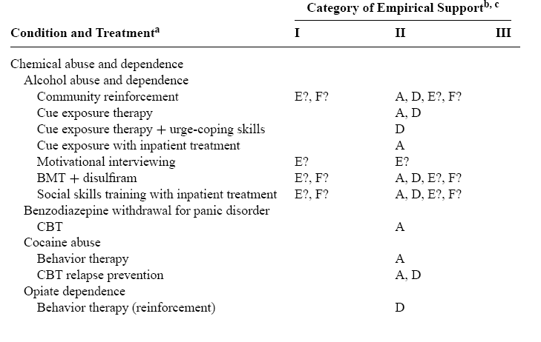
Chambless & Ollendick 2001
CRA/CBT
CBT/CRA
CBT/CRA
CRA + VBRT
CRA/CBT + CM
Annu. Rev. Psychol. 2001.52:685-716
Notes:
The work of several such task forces and other groups reviewing empirically supported treatments (ESTs) in the United States, United Kingdom, and elsewhere is summarized here, along with the lists of treatments that have been identified as ESTs.
Treatments in category I are supported by at least two rigorous randomized controlled trials (RCTs) showing their superiority to placebo control conditions or another bona fide treatment. Alternatively, work groups following task force criteria (Chambless et al 1998) accepted a large series of rigorous single case experiments as meeting this definition, and authors in the Nathan & Gorman volume (1998) may have accepted the use of a waiting list control group for comparison.
Treatments in category II were typically supported by at least one RCT in which the treatment proved superior to a control condition or alternative bona fide treatment. Also, most groups followed the task force criteria in relegating treatments
demonstrated to be efficacious only by comparison to waiting list control groups to this category, regardless of the number of supporting studies, and accepted a small series of rigorous single case experiments as meeting threshold for this level.

Slide 43
Community Reinforcement Approach (CRA) Cognitive Behavior Therapy (CBT) Contingency Management (CM)
CM
CBT
CRA
BEHAVIORAL APPROACHES
Notes:
These approaches are related and sometimes are used together
CBT focuses on training skills (e.g., communication skills, relapse prevention skills)
CM focuses in rearranging the events that set the occasion for behavior or provide reinforcement or punishment of behavior
CRA is a form of CM that arranges natural, social reinforcers rather than artificial, tangible ones
Goals of CRA include:
arranging for drug use and abstinence to be readily detected by the community
Having the community reinforce drug abstinence
Having the community ignore drug use or have it result in loss of reinforcement
increase reinforcement from non-drug sources
Goals of CM
Provide reinforcement for desired behaviors
- Positive reinforcement gives the person something when the desired behavior is performed (e.g., less frequent drug court appearances)
- Negative reinforcement removes something when the desired behavior occurs (e.g., expunge criminal record for completing drug court)

Slide 44
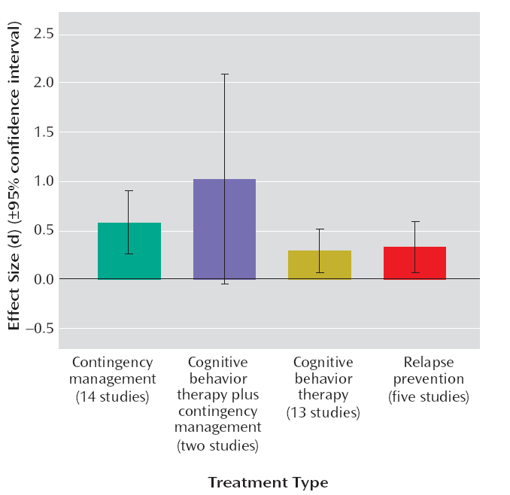
Effect Size by Treatment Type
d = .58
d = 1.02
d = .28
d = .32
Dutra et al. (2008 ) Am J Psychiatry 2008; 165:179–187

Slide 45
Cocaine Dependence Treatments
CM (Only cocaine abstinence reinforced) Risk Ratio = 3.11 (P < .0001)
CM (Simultaneous abstinence of heroin & cocaine reinforced)
Risk Ratio = 1.17 (P = .19)
CBT
Risk Ratio = 1.68 (P = .11)
CM & CBT
Risk Ratio = 2.96 (P = .01)
Fig. Efficacy of adjunctive interventions on sustained cocaine abstinence.
Abbreviations: CBT = Cognitive Behavioral Treatment, CM = Contingency Management, IV = Inverse Variance
Castells et al., (2009). The American Journal of Drug and Alcohol Abuse, 35:339–349.

Slide 46
Experience with Empirically-Supported Treatments

Slide 47
Challenges to Dissemination
Payment services may be an issue
Usual treatment in the community is delivered in groups
Training and treatment fidelity are problematic

Slide 48
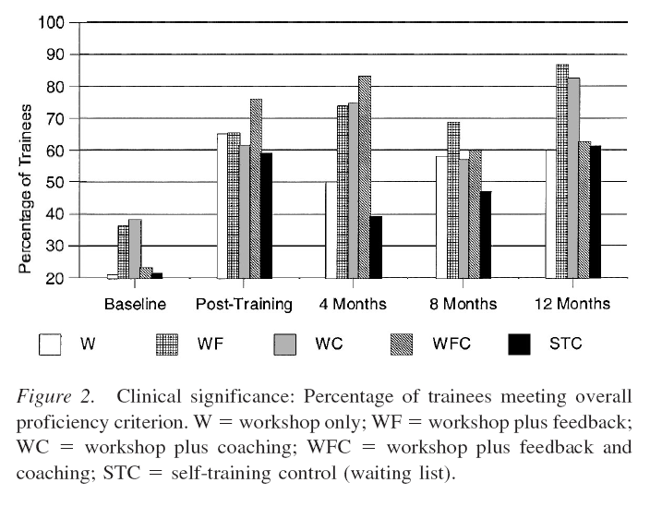
Counselor Training is Difficult
Miller at al. (2004). JCCP, 72 (6), 1050–1062
Notes:
Motivational Interviewing is a therapist style as well as a strategy
Style is to be accepting, avoid resistance, and accept that the client knows themselves best and is the only one who has control of his or her behavior
Strategy is to build discrepancy between the clients long-term goals and important life roles (parent) versus his or her AOD use

Slide 49
Treatment Staff Turnover
Only 47% of the directors had been in their directorial position more than 1 year
McLellan & Meyers, 2004
Contemporary addiction treatment:
A review of systems problems for adults and adolescents

Slide 50
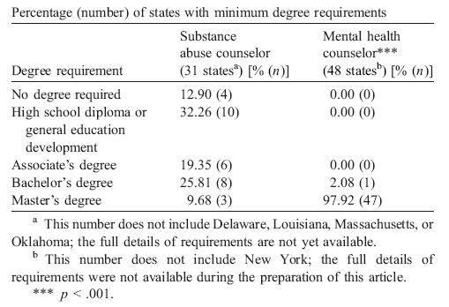
Counselor Education & Training
65% states require
minimum education less than a bachelors degree
for substance abuse counselors
98% states require
minimum education of
masters degree
for mental health counselors
Kerwin et al. (2006). JSAT, 30, 173– 181

Slide 51
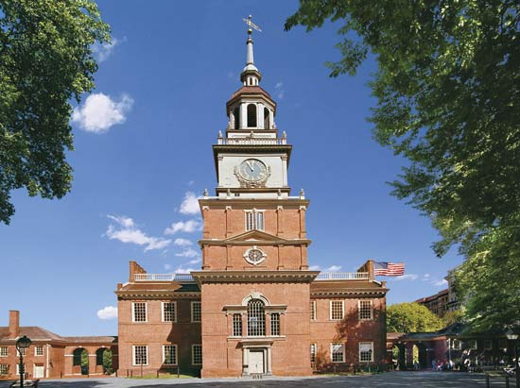
ACKNOWLEDGEMENTS
Research Supported by NIH
National Institute on Drug Abuse
National Institute on Alcohol Abuse and Alcoholism
R01 DA 012720 R01 DA 015991
R01 DA 019932 R01 DA 012720
R01 DA 018696 R01 AA 017867
R01 DA 017444 P50 DA 027841

